Slide 1
Introduction to Database

Slide 2
Backend Development
Web development activities that are done at the back end of programs.
It covers server-side web application logic, like writing APIs, creating libraries, and working with system components instead of frontend development, which focuses on customer-facing services and programs.

Slide 3
Backend developer
They take care and maintain the back-end of a website including databases, servers, and apps, and they control what you don't see.
They build code that allows a database and an application to communicate with one another.
Their job focus on website architecture, and writing code that communicates between the website’s database and the user's browser. Data integrity must be ensured.

Slide 4
Backend developer skills
Data structures and Algorithms:
A backend developer creates code that does relational mapping to retrieve data from a database.
It's crucial to have a good understanding of how they work.

Slide 5
Contd…
2. Programming Languages and Frameworks:
There should be an in-depth understanding of backend programming languages, i.e.;
Python is the most widely used programming language. It is adaptable and simple to use. Backend development is done with Python frameworks like Django and Flask.
NodeJS and ExpressJS are examples of JavaScript environments.
Java, in particular, was designed from the start to be used on the server. Spring and Java Server Faces are two popular Java frameworks.
In Windows systems, the C language is the recommended architecture for backend programming.
PHP, Perl, and Ruby are some of the other languages available.

Slide 6
Contd…
3. Database Management Systems:
A backend developer creates code that does relational mapping to retrieve data from a database. MySQL, SQL SERVER and PostgreSQL, MongoDB, and Oracle Database are some of the most widely used DBMS. It's crucial to have a good understanding of how they work.
4. Web Hosting Platforms:
Web hosting solutions enable you to place your product on a cloud service provider and access it via the internet.
E.g.: Amazon Web Services(AWS), Google Cloud Platform(GCP), Microsoft Azure and Heroku.

Slide 7
Backend Developer Responsibilities
They must first gain a thorough knowledge of the website's performance demands and goals to design effective and efficient solutions
Application Programming Interfaces (APIs) development and administration.
Develop data acceptance and storage solutions for websites, particularly for those involved in payment processing.
Write, test, and maintain development solutions for code-related problems are all part of the job.
To identify new features, communicate effectively with developers, designers, and system administrators.
Create a website architecture by utilizing correct product lifecycle approaches.
Provide remedies to difficulties with the system.
Debug and troubleshoot apps.

Slide 8
Database
It is the collection of organized data which is structured and is stored electronically on a computer system.
It can store data in the form of tables depending upon the type of database.
It's primary goal is to store a huge amount of data.
Also, to store a large number of dynamic websites on the Internet today.
Data can then be accessed, managed, updated, regulated, and organized efficiently.
For writing and retrieving data, most databases utilize structured query language (SQL).
E.g.: MySQL, Oracle, MongoDB, PostgreSQL, SQL Server, etc.

Slide 9
DBMS(Data Base Management System)
It is a software that manages database by storing, retrieving, and manipulating the data from a database.
E.g.: Oracle, MySQL etc. are well-known DBMS tools.
Functions:
It provides an interface for performing various activities such as creation, deletion, and modification of the data.
It allows users to design databases that meet their specific needs.
It is a collection of programs that respond to user commands.
It ensures the database's safety by providing security patterns like password protections and verification to ensure access to only authorized users.
It can be easily used using the queries (a request for information from DBMS).

Slide 10
Contd…
DBMS is a collection of programs that facilitates users to create and maintain a database.
In other words, DBMS provides us an interface or tool for performing different operations such as the creation of a database, inserting data into it, deleting data from it, updating the data, etc.

Slide 11
Types of DBMS
Eight common database management systems are:
Hierarchical databases
Network databases
Relational databases
Object-oriented databases
Graph databases
ER model databases
Document databases
NoSQL databases

Slide 12
Hierarchical Databases
In this model, data is stored in a parent-children relationship node.
Here, besides actual data, records also contain information about their groups of parent/child relationships.
Here, data is organized into a tree-like structure.
The data is stored in the form of a collection of fields where each field contains only one value.
The records are linked to each other via links into a parent-children relationship. Here, each child record has only one parent. A parent can have multiple children.
To retrieve a field’s data, we need to traverse through each tree until the record is found.
It was developed by IBM in the early 1960s.
However, the hierarchical structure is simple, but it is inflexible due to the parent-child one-to-many relationship.
Application: to build high-performance and availability applications usually in the banking and telecommunications industries.
E.g.: the IBM Information Management System (IMS) and Windows Registry.

Slide 13
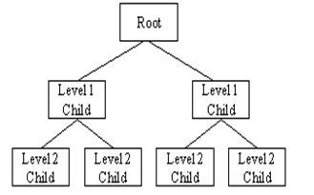
Contd…
Fig: Hierarchical database

Slide 14
Network DBMSs
They use network structure to create a relationship between entities.
Application: used on large digital computers.
Network databases are hierarchical databases, but unlike hierarchical databases where one node can have a single parent only, a network node can have a relationship with multiple entities.
A network database looks more like a cobweb or interconnected network of records.
Here, children are called members and parents are called occupiers. The difference between each child or member is that it can have more than one parent.
Data in a network database is organized in many-to-many relationships.
E.g.: the Integrated Data Store (IDS), IDMS (Integrated Database Management System), Raima Database Manager, TurboIMAGE, and Univac DMS-1100.

Slide 15
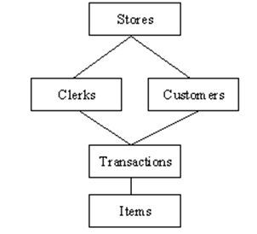
Contd…
Fig: Example of Network DBMSs

Slide 16
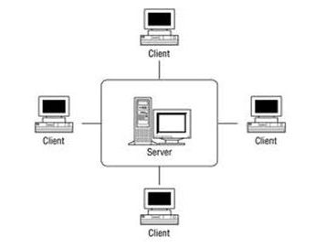
Contd…
Fig: Example of Network DBMS

Slide 17
Relational DBMS
Here, the relationship between data is relational and data is stored in tabular form of columns and rows.
Each column of a table represents an attribute and each row in a table represents a record.
Each field in a table represents a data value.
Structured Query Language (SQL) is the language used to query RDBMS, including inserting, updating, deleting, and searching records.
It work on each table that has a key field that uniquely indicates each row.
These key fields can be used to connect one table of data to another.
They are the most popular and widely used databases.

Slide 18
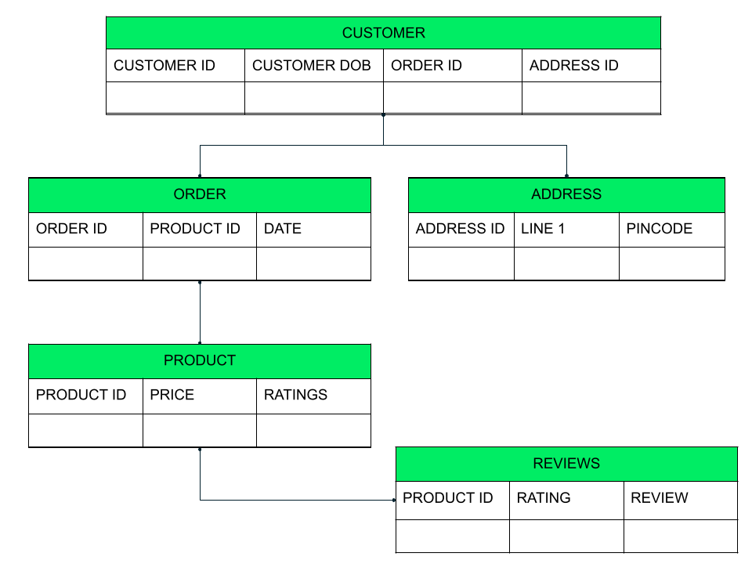
Contd…
Fig: Example of relational DBMS

Slide 19
Object-Oriented Model
It takes more than the storage of programming language objects.
It provides full-featured database programming capabilities while containing native language compatibility.
It adds the database functionality to object programming languages. Applications require less code, use more natural data modelling, and code bases are easier to maintain.
Object developers can write complete database applications with a decent amount of additional effort.
The object-oriented database derivation is the integrity of object-oriented programming language systems and consistent systems.
The power of object-oriented databases comes from the cyclical treatment of both consistent data, as found in databases, and transient data, as found in executing programs.

Slide 20
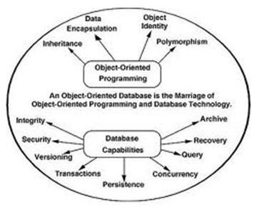
Contd…
Fig: Object-oriented DBMS

Slide 21
Non-relational database
They are sometimes called NoSQL (Not Only SQL), is any kind of database that doesn’t use the tables, fields, and columns structured data concept from relational databases.
They have been designed with the cloud in mind, making them great at horizontal scaling.
Consider the same customer example as above. In this case, however, we are able to view all the data of one customer in a single place as a single document.

Slide 22
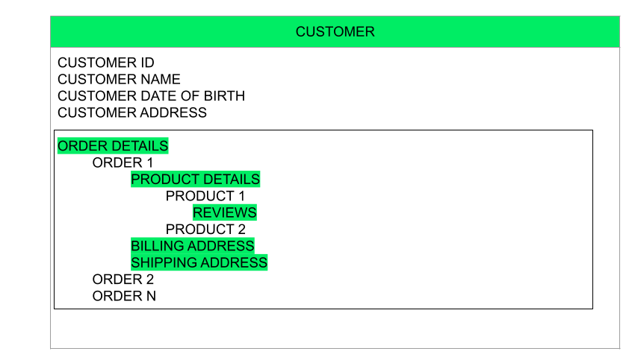
Contd…
Fig: Example 1 of object-oriented DBMS
Fig: Example of Non-relational DBMS

Slide 23
XAMPP
Apache: The open source web server Apache is the most widely used server worldwide for delivery of web content. The server application is made available as a free software by the Apache Software Foundation.
MySQL/MariaDB: in MySQL, XAMPP contains one of the most popular relational database management systems in the world. In combination with the web server Apache and the scripting language PHP, MySQL offers data storage for web services. Current XAMPP versions have replaced MySQL with MariaDB.
PHP: the server-side programming language PHP enables users to create dynamic websites or applications. PHP can be installed on all platforms and supports a number of diverse database systems.
Perl: the scripting language Perl is used in system administration, web development, and network programming. Like PHP, Perl also enables users to program dynamic web applications.

